Slide 1
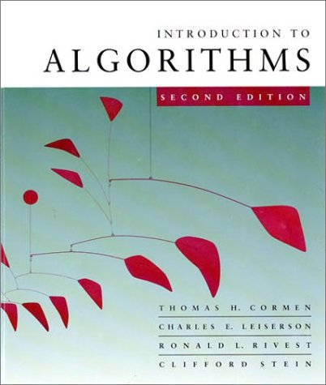


Slide 2
OBJECTIVES
After reading this chapter, the reader should
be able to:
Understand the concept of an algorithm.
Define and use the three constructs for developing
algorithms: sequence, decision, and repetition.
Understand and use three tools to represent algorithms:
flowchart, pseudocode, and structure chart.
Understand the concept of modularity and subalgorithms.
List and comprehend common algorithms.

Slide 4
8.1
CONCEPT

Slide 5
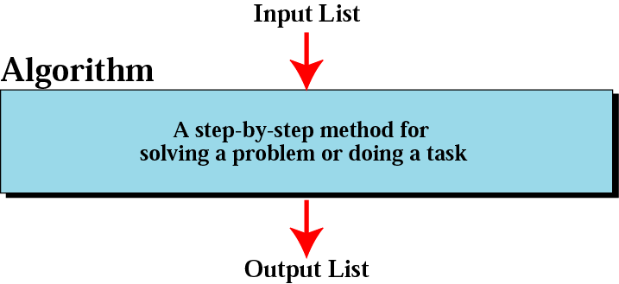
Figure 8-1
Informal definition of an algorithm
used in a computer

Slide 6
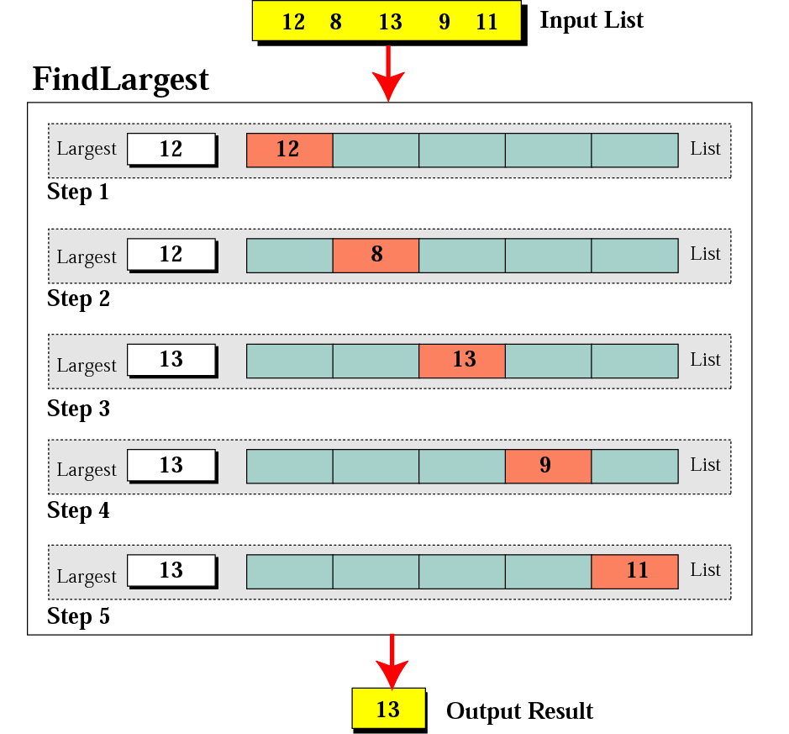
Figure 8-2
Finding the largest integer
among five integers

Slide 7
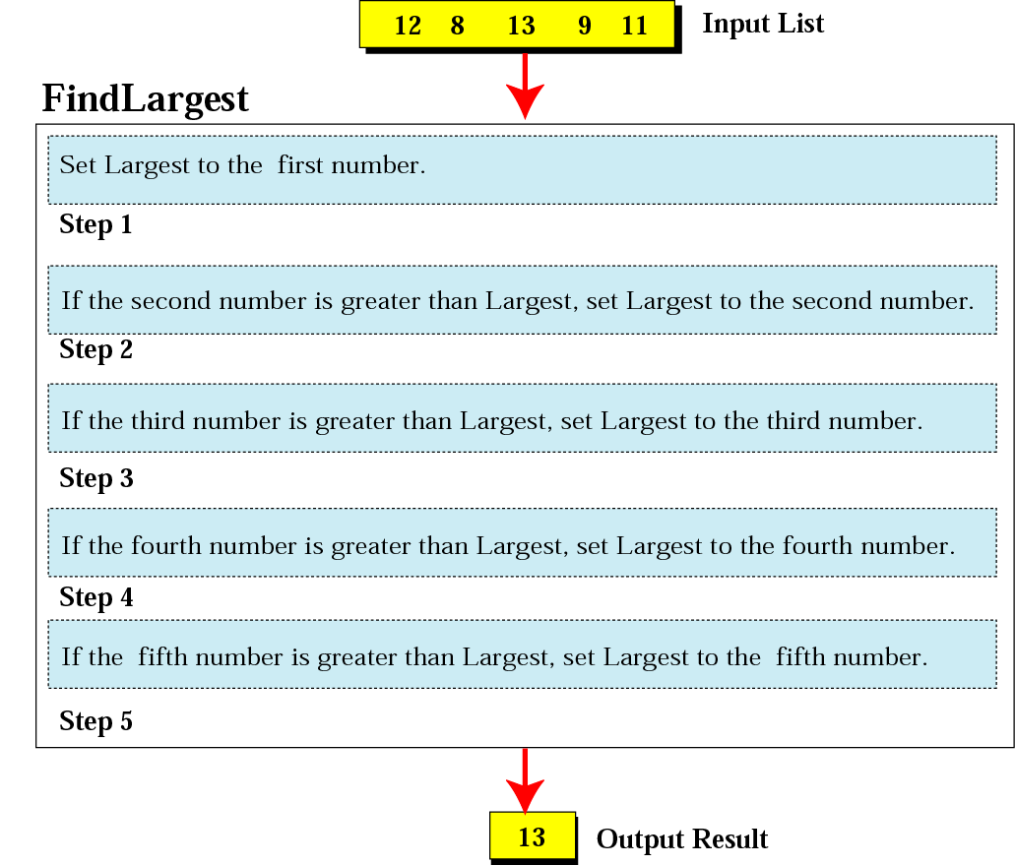
Figure 8-3
Defining actions in FindLargest algorithm

Slide 8
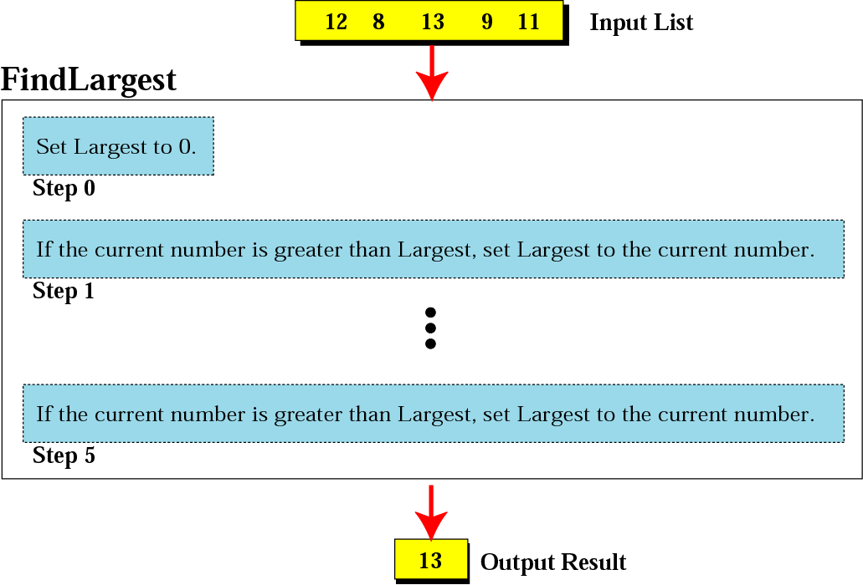
Figure 8-4
FindLargest refined

Slide 9
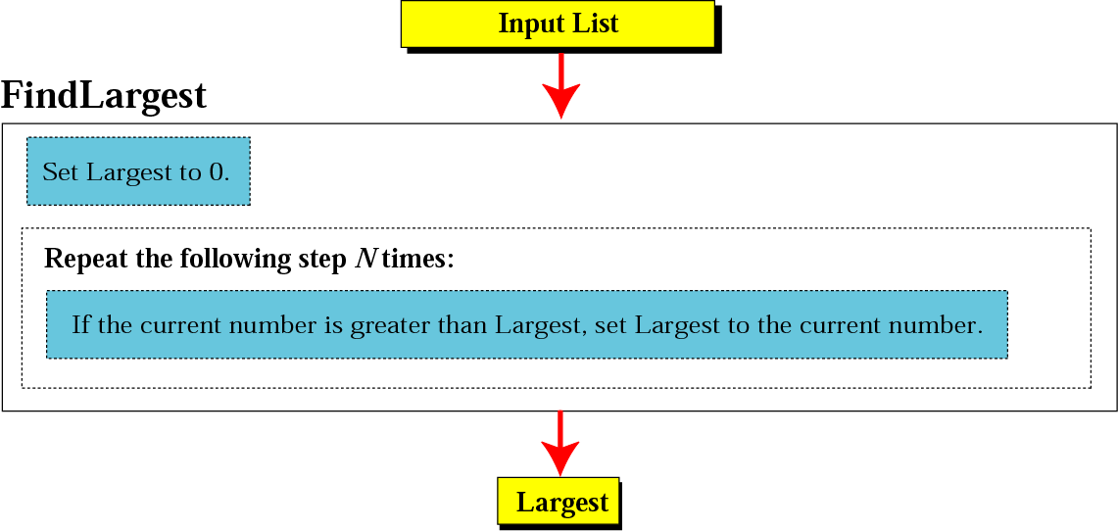
Figure 8-5
Generalization of FindLargest

Slide 10
8.2
THREE CONSTRUCTS

Slide 11
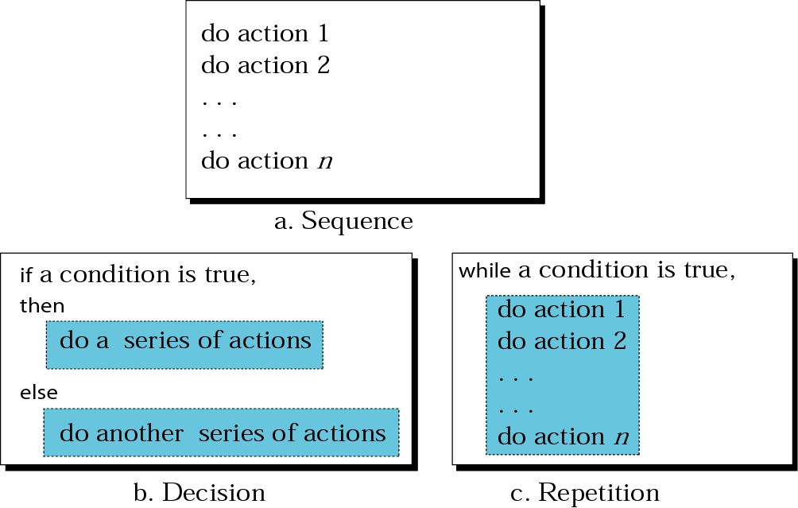
Figure 8-6
Three constructs

Slide 12
8.3
ALGORITHM
REPRESENTATION

Slide 13
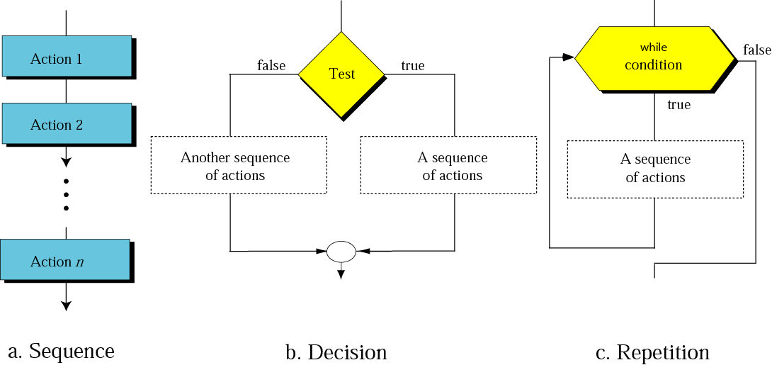
Figure 8-7
Flowcharts for three constructs

Slide 14
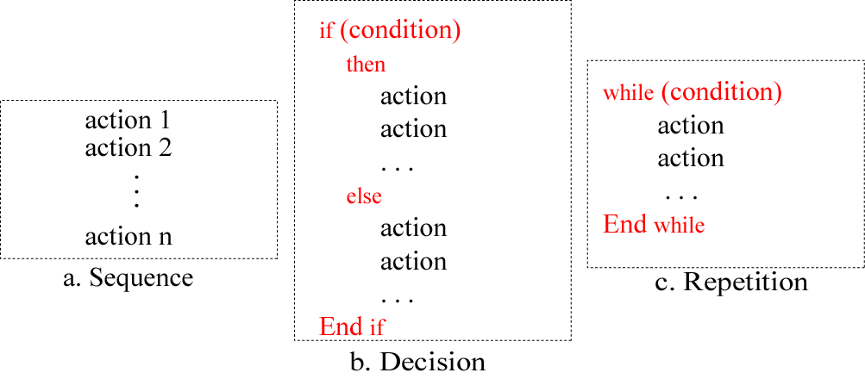
Figure 8-8
Pseudocode for three constructs

Slide 15
Example 1
Write an algorithm in pseudocode that finds the average of two numbers
Solution
See Algorithm 8.1 on the next slide.

Slide 16
Algorithm 8.1:
Average of two
AverageOfTwo
Input: Two numbers
Add the two numbers
Divide the result by 2
Return the result by step 2
End

Slide 17
Example 2
Write an algorithm to change a numeric grade to a pass/no pass grade.
Solution
See Algorithm 8.2 on the next slide.

Slide 18
Algorithm 8.2:
Pass/no pass Grade
Pass/NoPassGrade
Input: One number
if (the number is greater than or equal to 70)
then
  1.1 Set the grade to “pass”
  else
  1.2 Set the grade to “nopass”
  End if
Return the grade
End

Slide 19
Example 3
Write an algorithm to change a numeric grade to a letter grade.
Solution
See Algorithm 8.3 on the next slide.

Slide 20
Algorithm 8.3:
Letter grade
LetterGrade
Input: One number
1. if (the number is between 90 and 100, inclusive)
then
  1.1 Set the grade to “A”
  End if
2. if (the number is between 80 and 89, inclusive)
then
  2.1 Set the grade to “B”
  End if
Continues on the next slide

Slide 21
Algorithm 8.3:
Letter grade (continued)
3. if (the number is between 70 and 79, inclusive)
then
  3.1 Set the grade to “C”
  End if
4. if (the number is between 60 and 69, inclusive)
then
  4.1 Set the grade to “D”
  End if
Continues on the next slide

Slide 22
Algorithm 8.3:
Letter grade (continued)
5. If (the number is less than 60)
then
  5.1 Set the grade to “F”
  End if
6. Return the grade
  End

Slide 23
Example 4
Write an algorithm to find the largest of a set of numbers. You do not know the number of numbers.
Solution
See Algorithm 8.4 on the next slide.

Slide 24
Algorithm 8.4:
Find largest
FindLargest
Input: A list of positive integers
Set Largest to 0
while (more integers)
2.1 if (the integer is greater than Largest)
then
2.1.1 Set largest to the value of the integer
End if
End while
Return Largest
End

Slide 25
Example 5
Write an algorithm to find the largest of 1000 numbers.
Solution
See Algorithm 8.5 on the next slide.

Slide 26
Algorithm 8.5:
Find largest of 1000 numbers
FindLargest
Input: 1000 positive integers
Set Largest to 0
Set Counter to 0
while (Counter less than 1000)
3.1 if (the integer is greater than Largest)
then
3.1.1 Set Largest to the value of the integer
End if
3.2 Increment Counter
End while
Return Largest
End

Slide 27
8.4
MORE FORMA DEFINITION
Ordered set
Unambiguous steps
Effectiveness
Termination

Slide 28
8.5
SUBALGORITHMS

Slide 29
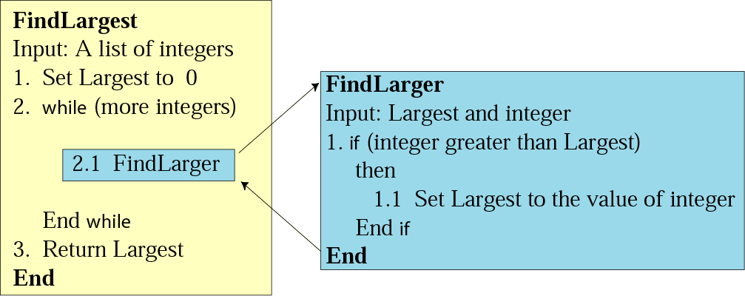
Figure 8-9
Concept of a subalgorithm

Slide 30
Algorithm 8.6:
Find largest
FindLargest
Input: A list of positive integers
Set Largest to 0
while (more integers)
2.1 FindLarger
End while
Return Largest
End

Slide 31
Subalgorithm:
Find larger
FindLarger
Input: Largest and current integer
if (the integer is greater than Largest)
then
1.1 Set Largest to the value of the integer
End if
End

Slide 32
8.6
BASIC
ALGORITHMS

Slide 33
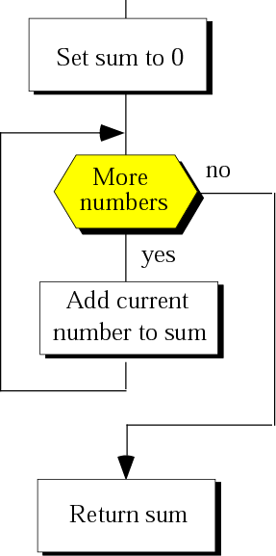
Figure 8-10
Summation

Slide 34
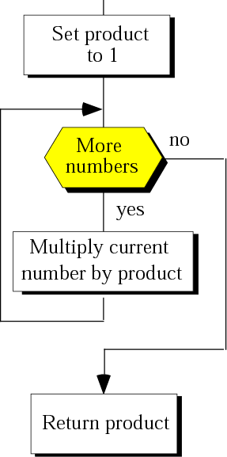
Figure 8-11
Product

Slide 35
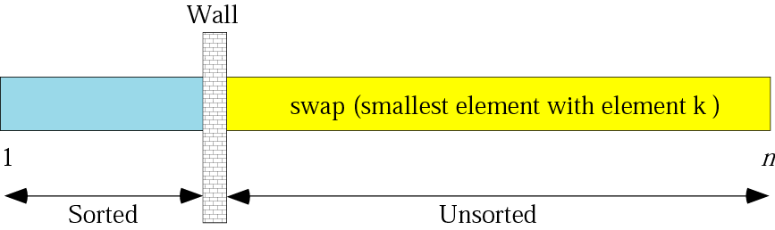
Figure 8-12
Selection sort

Slide 36
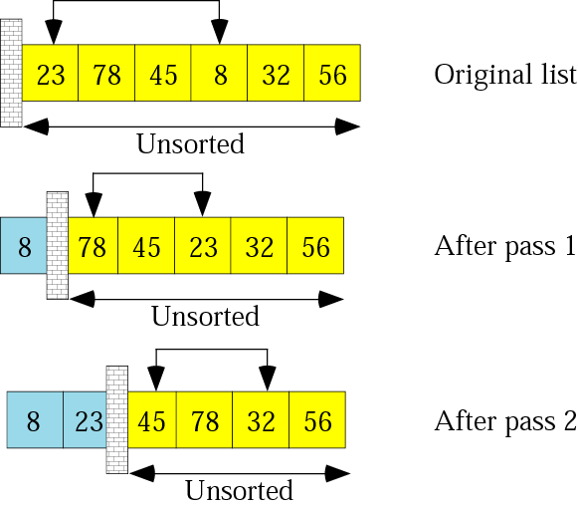
Figure 8-13: part I
Example of selection sort

Slide 37
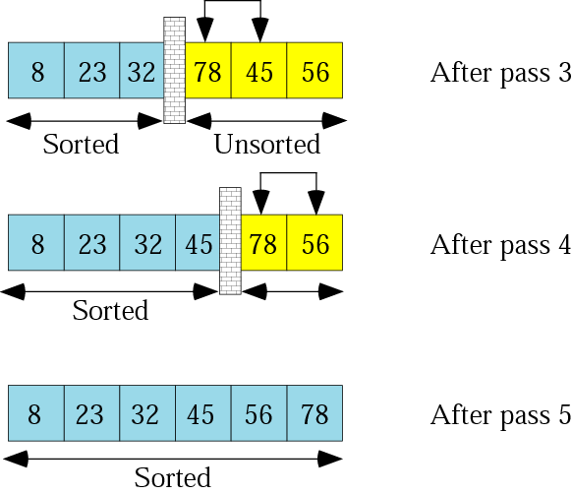
Figure 8-13: part II
Example of selection sort

Slide 38
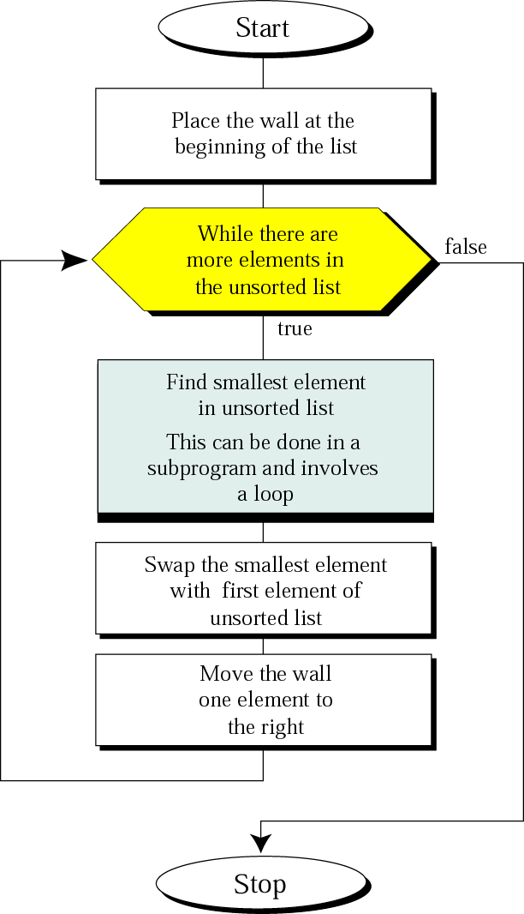
Figure 8-14
Selection sort
algorithm

Slide 39
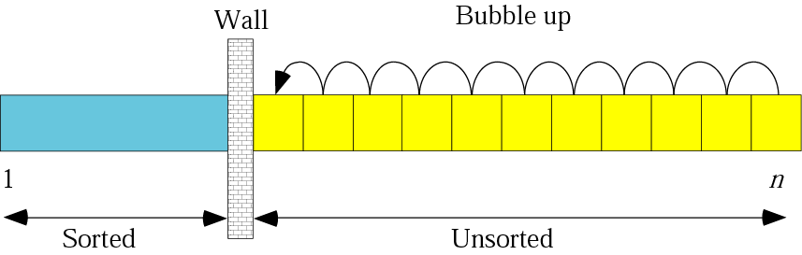
Figure 8-15
Bubble sort

Slide 40
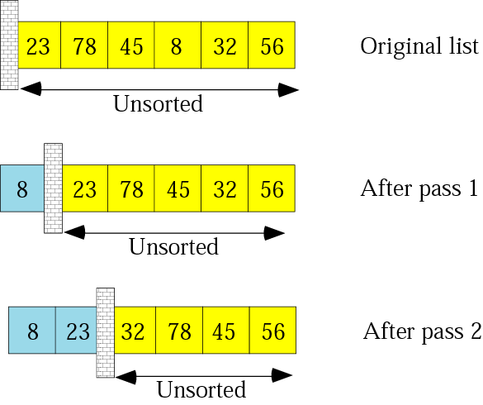
Figure 8-16: part I
Example of bubble sort

Slide 41
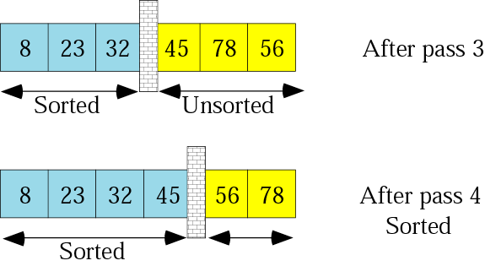
Figure 8-16: part II
Example of bubble sort

Slide 42
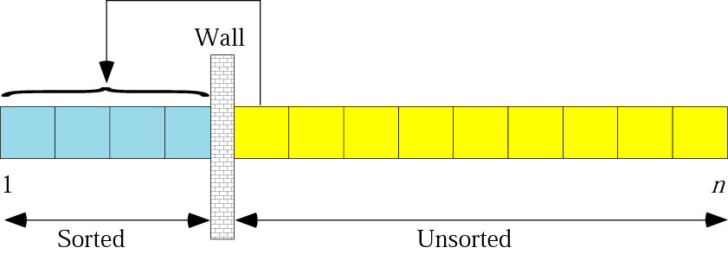
Figure 8-17
Insertion sort
Algorithm
// Sort an arr[] of size n
insertionSort(arr, n)
Loop from i = 1 to n-1.
……a) Pick element arr[i] and insert it into sorted sequence arr[0…i-1]

Slide 43
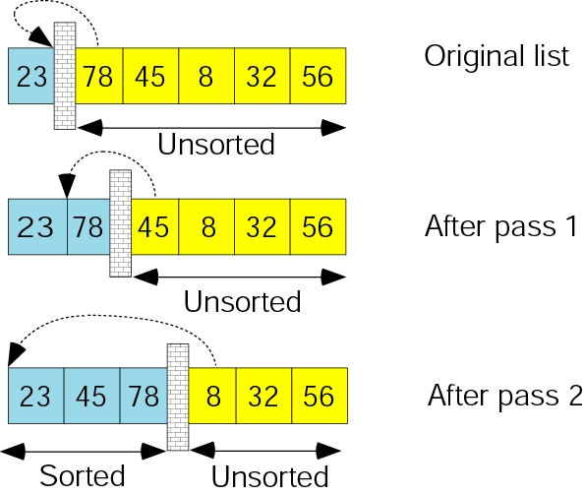
Figure 8-18: part I
Example of insertion sort

Slide 44
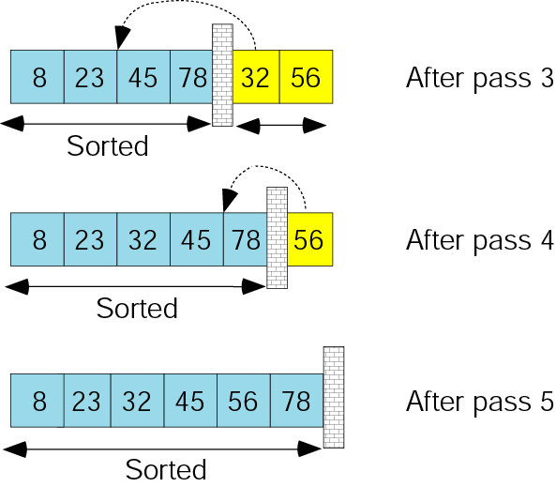
Figure 8-18: part II
Example of insertion sort

Slide 45
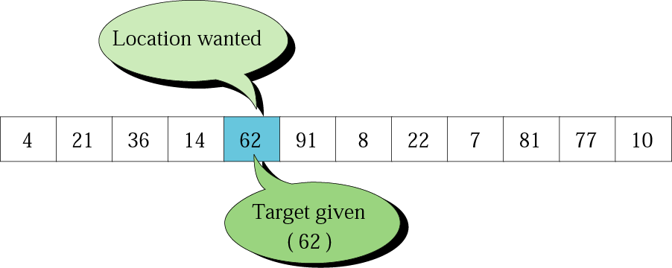
Figure 8-19
Search concept

Slide 46
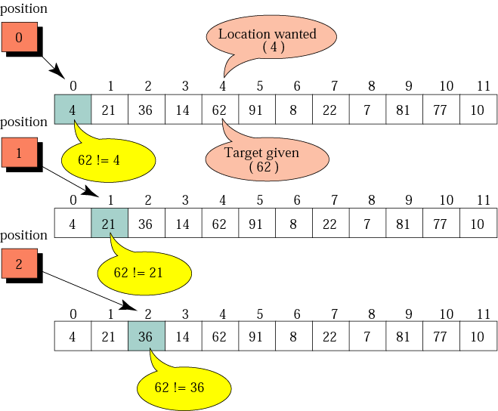
Figure 8-20: Part I
Example of a sequential sort

Slide 47
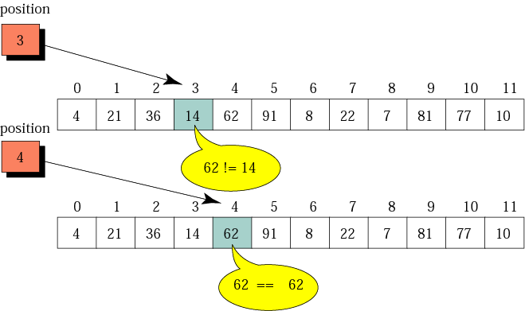
Figure 8-20: Part II
Example of a sequential sort

Slide 48
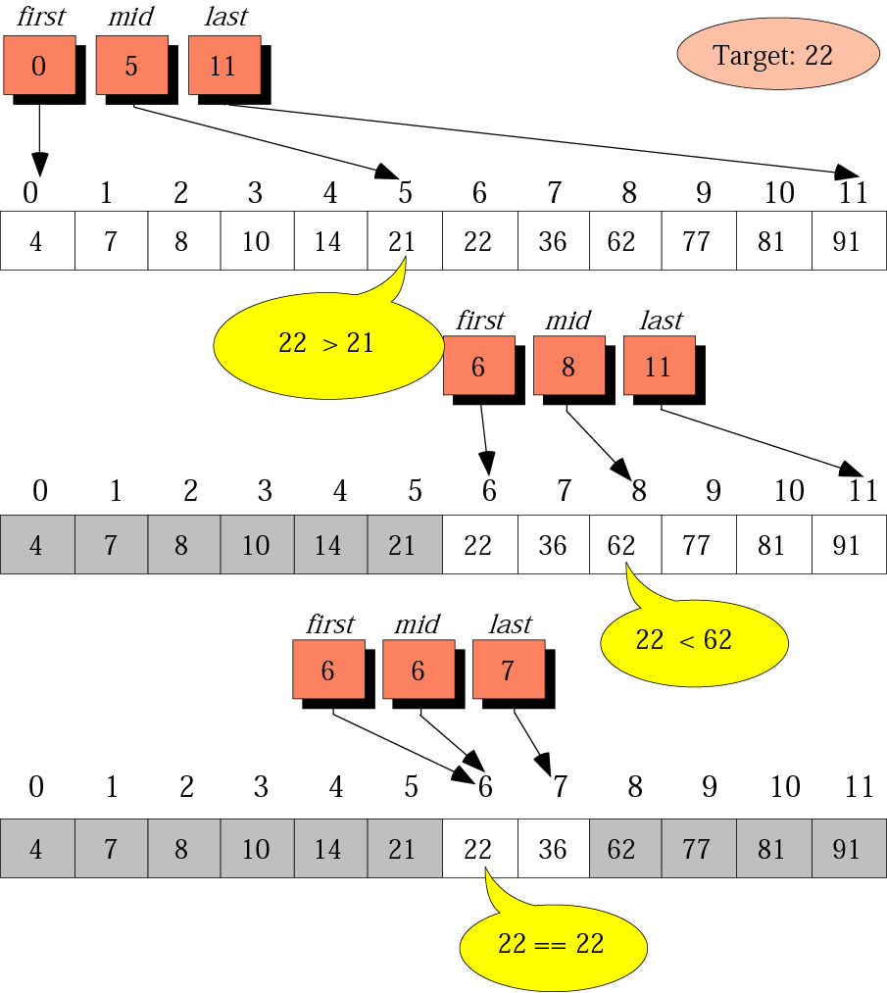
Figure 8-21
Example of a binary sort

Slide 49
8.1
RECURSION

Slide 50
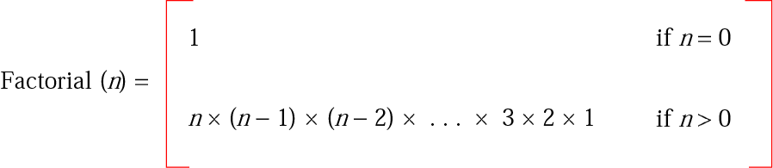
Figure 8-22
Iterative definition of factorial

Slide 51
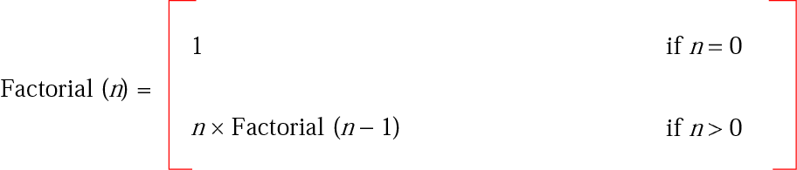
Figure 8-23
Recursive definition of factorial

Slide 52
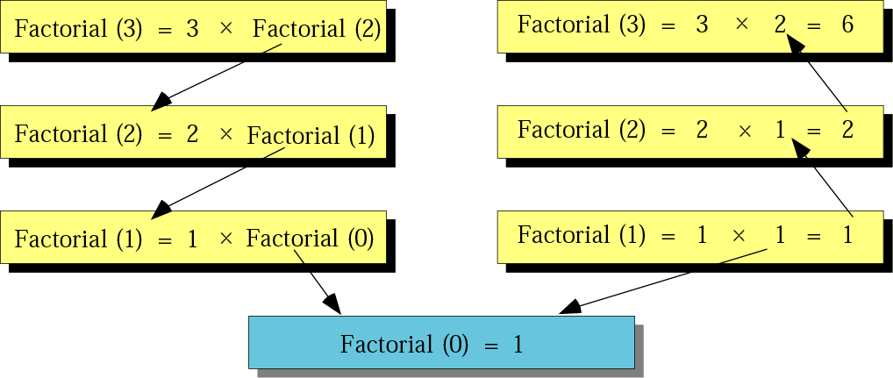
Figure 8-24
Tracing recursive solution to factorial problem

Slide 53
Algorithm 8.7:
Iterative factorial
Factorial
Input: A positive integer num
Set FactN to 1
Set i to 1
while (i is less than or equal to num)
3.1 Set FactN to FactN x I
3.2 Increment i
End while
Return FactN
End

Slide 54
Algorithm 8.8:
Recursive factorial
Factorial
Input: A positive integer num
if (num is equal to 0)
then
1.1 return 1
else
1.2 return num x Factorial (num – 1)
End if
End

